Slide 1
Turkish export and import analysis
Author: Paweł Wolanowski
Contact:
wolanowski.pawel@gmail.com
https://www.linkedin.com/in/pawel-wolanowski/
Project location:
https://github.com/L4wr3nd/TradeTR
https://public.tableau.com/app/profile/lawrick

Slide 2
Project objectives
Thematic
Identify basic characteristics of Turkish export and import
Check latest results of leading countries in generating Turkish export and import in 2021
Technical
Use various tools/software to achieve thematical objectives
Notes:
Insert a map of your country.

Slide 3
Data
Datasets’ names:
Imports by Countries
Exports by Countries
Publish date:
31.12.2021 (thus without data from December 2021)
Source:
https://data.tuik.gov.tr/Kategori/GetKategori?p=dis-ticaret-104&dil=2
Notes:
Insert a map of your country.

Slide 4
Software used
MS Excel
Python 3 (Jupyter Notebook & Pandas)
MySQL Workbench 8.0
Tableau Public 2021.4
Data overview
Data preparation for further analysis in other software
Data visualisation and analysis
Notes:
Insert a map of your country.

Slide 5
Software used
MS Excel
Python 3 (Jupyter Notebook & Pandas)
MySQL Workbench 8.0
Tableau Public 2021.4
Data overview
Placing missing data in records
Creating records of all countries in years where they are missing
Creating new dataframe/table with year/year change
Data visualisation and analysis
Notes:
Insert a map of your country.

Slide 6
Software used
MS Excel
Python 3 (Jupyter Notebook & Pandas)
MySQL Workbench 8.0
Tableau Public 2021.4
Merging data from different tables
Creating final datatables for analysis
Notes:
Insert a map of your country.

Slide 7
Software used
MS Excel
Python 3 (Jupyter Notebook & Pandas)
MySQL Workbench 8.0
Tableau Public 2021.4
Data visualisation and analysis
Notes:
Insert a map of your country.

Slide 8
Methodology
Excel
Data overview, cleaning and formatting
Python
Data overview and fixing, putting missing records, creating new table
Excel
First analysis and further data calculation, preparing files to MySQL and Tableau
MySQL
Creating datatables
Tableau / Excel
Data visualisation and analysis
Notes:
Insert a map of your country.

Slide 9
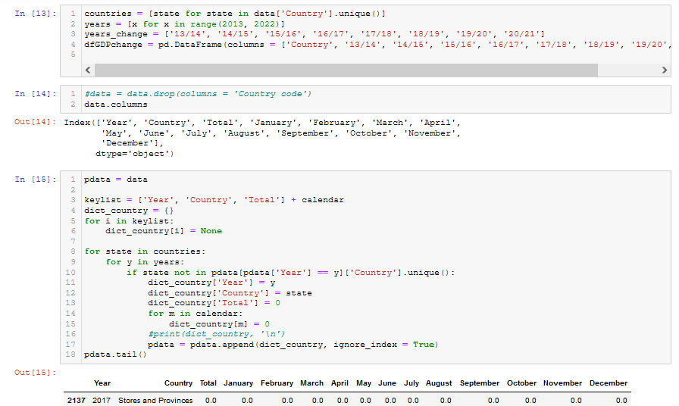
Methodology – PYTHON sample code
Notes:
Insert a map of your country.

Slide 10
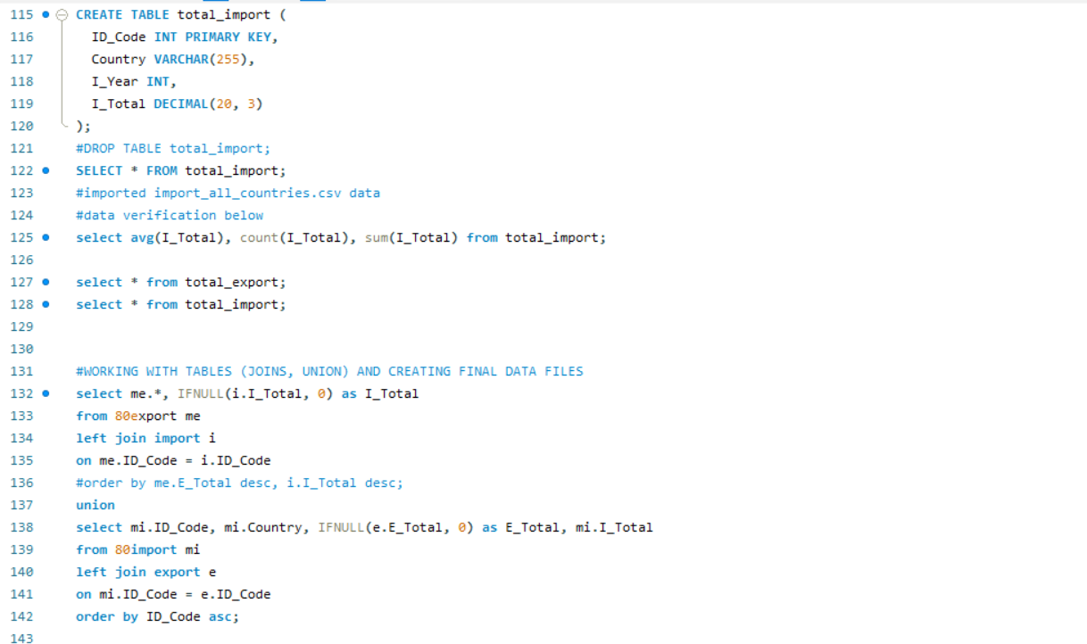
Methodology – MySQL sample code
Notes:
Insert a map of your country.

Slide 11
Results – export and import in 2013-2021(Dec 2021 excluded)
Notes:
Insert a map of your country.

Slide 12
Results – export and import in 2013-2021(Dec 2021 excluded)
Notes:
Insert a map of your country.

Slide 13
Results - top countries generating 80% of export or import
Notes:
Insert a map of your country.

Slide 14
Results - top countries generating 80% of export or import
Notes:
Insert a map of your country.

Slide 15
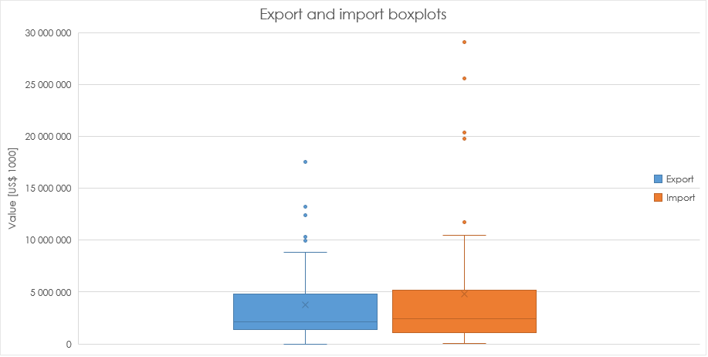
Results - top countries generating 80% of export or import
Notes:
Insert a map of your country.

Slide 16
discussion
Notable year/year growth of both export and import in 2021 even without December results
Apart from 2017, import declined until 2020 since it began to rise
Highly variable changes in annual export and import values each year
Gradual increase of export/import ratio over the years from long-period perspective
Significant share of Confidential Country in import and total trade (2021)
Strong import influence from China and Russia with notable results of Confidential Country and Germany (2021)
Export to majority of leading trade countries is higher than or close to import (2021)
Low amout of import decline among leading trade countries (2021)
Mostly a growth of export to leading trade countries (2021)
Germany has the highest value of total trade and exports. The next highest in total trade value are China, Russia, the US and Italy (2021)
No simultaneous decline of import and export in any leading trade country (2021)
Notes:
Insert a map of your country.

Slide 17
Conclusions
Turkish export is gradually getting closer to import
Trade’s annual changes are unstable
In short-term, Turkish international trade experienced growth in both import and export
Turkish import in 2021 was strongly influenced by few particual trading partners and was more scattered than export
Notes:
Insert a map of your country.

Slide 18
Further research perspectives
Investigation of trade with the biggest trading partners individually during longer period either from only-import, only-export and general perspectives
Checking information sources (media) about both clear (e.g. inflation, COVID-19, political instability incl. coup) and unclear causes of Turkish trade instability
Import and export analysis from different context (e.g. type of goods)
Analysis update using data including Dec 2021 results
Notes:
Insert a map of your country.

